Slide 1
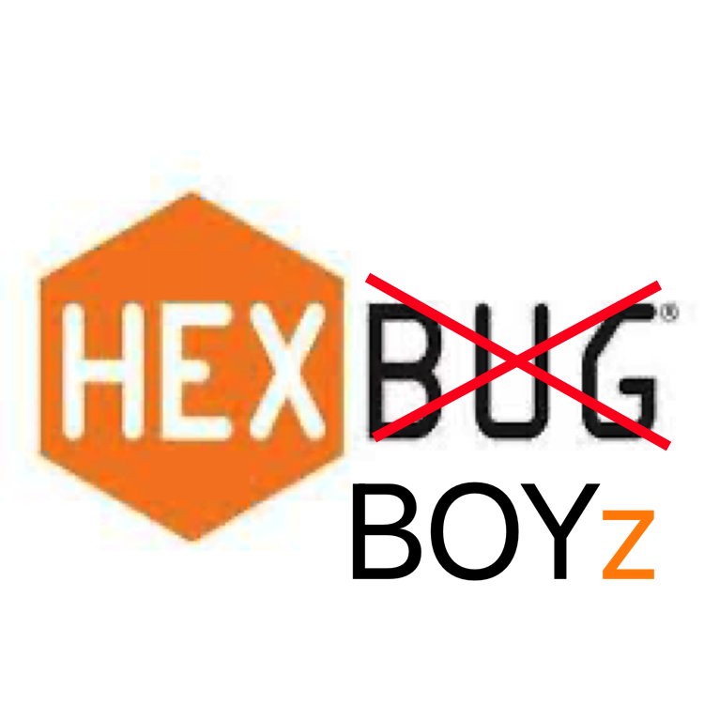
Minimum Viable Product
HexBoyz - Dungeon Jump

Slide 2
Brief Review
Goal:
To return to Monkey
What is our game?
An alternating-perspective 2D collect-athon RPG
Involves monkeys, a human, and a coming of age story

Slide 3
Brief Overview (***Hexboy eyes only***)
Player wakes up on a deserted island. The player is human and they go through trials and tribulations setout for them by monkeys. The enemies they encounter in dungeons scattered throughout the overworld will also be monkeys. At the end of the game, it’ll be revealed that the reason the player was going through these trials was as a “rite of passage” and they’ll be accepted as one of the monkeys, with a big party involving all the enemies and helpful monkeys at the end. During this party, they’ll be able to converse with all the monkeys and understand them. During gameplay, the player will only ever “faint” since the monkeys don’t actually want to kill them.
Could add master oogway saying “mmmm…monkey” when game beaten
Could add “Successfully returned to monkey” when game beaten

Slide 4
Demo Play Time!
Will show:
Main character controlled by user
At least 2 NPCs that respond to main character
Each person’s code called at least once

Slide 5
Gantt Chart
Is each person on schedule?
What’s the cost so far?
Estimated cost to completion?
Any road blocks?
Offer proof of feature completion

